Slide 1
FOOD DIET CHART RECOMMENDATION SYSTEM

Slide 2
ABSTRACT
The majority of people in today's world are extremely concerned with their health and fitness and alternate between needing to lose weight, gain weight, or stay healthy. Therefore, we suggest a diet and exercise recommendation system that offers a list of foods and exercise suggestions based on user inputs like height, weight, and age used to determine their BMI. Along with other pertinent information including proteins, fats, calcium, iron, potassium, sodium, sugar, vitamin D, carbohydrates, and fibre, various nutrients and calories are taken into account. Several food items, including popular vegetarian and non-vegetarian cuisines, are taken into account.

Slide 3
Introduction
The introduction summarizes the motivation for developing a diet recommendation system using machine learning to suggest food items to users based on their preferences for weight loss, weight gain, or maintaining a healthy diet, driven by the difficulty people face in making healthy eating decisions due to the wide variety of food options and the connection between nutrition and various diseases.

Slide 4
EXISTING SYSTEM
The existing system described in the paper is the traditional approach of people consulting dieticians for diet recommendations.

Slide 5
Problem definition
Maintaining a balanced diet is essential for a healthy lifestyle, but many individuals struggle with selecting appropriate meals based on their nutritional needs. A dynamic, personalized diet chart can help users maintain a proper diet aligned with their fitness goals, lifestyle, and dietary preferences.
This system should:
Collect user input (age, gender, activity level, and diet type).
Generate a customized diet plan with meal suggestions for breakfast, lunch, and dinner.
Adjust meal plans based on the user's activity level (e.g., high-activity users may need additional protein intake).
Provide a simple and interactive way for users to receive their diet recommendations.

Slide 6
Limitations
Time-Consuming
Human Error
Limited Data Processing
Inconsistent Recommendations
Limited Personalization
Resource Intensive
Client Compliance
Lack of Real-Time Tracking
Limited Scope
Communication Barriers

Slide 7
PROPOSED SYSTEM
Developing a diet chart system with fitness practice guidance
To enhance the automation and less human intervention we develop an intelligent diet recommendation plan
Incluidng an chat bot to answer all the queries regarding the diet plan
uses machine learning algorithms to suggest food items based on user inputs and nutrient requirements for weight loss, weight gain, or healthy diet.

Slide 8
Advantages
Time-Efficient
Personalized Recommendations
Data-Driven Insights
Real-Time Tracking
Consistency and Accuracy
Cost-Effective
Convenience and Accessibility
Scalability
Integration with Other Health Data
Continuous Updates and Improvements

Slide 9
Methadology
Use of a MySQL database to store user information and data related to profiles, goals, and calorie counts
- Use of a regression tree model to determine the target caloric intake needed to maintain a person's weight, based on attributes like height and weight to calculate BMI
- The regression tree model selects the root node based on the predictor with the smallest sum of squared residuals, and continues splitting the data into smaller nodes until no further splits are possible

Slide 10
SURVEY 1
"Dietary Recommendations Based on Personal Data Using Mobile Applications"
Authors: L. R. Gouveia, L. P. L. F. S. Silva, et al.
Journal: Healthcare Technology Letters (2019)
This paper discusses how mobile applications can provide personalized dietary recommendations based on user data, including nutritional tracking and recommendations for better health outcomes.

Slide 11
SURVEY 2
"Mobile Health Apps for Personalized Nutrition and Diet Plans: A Review"
Authors: M. R. Uddin, M. A. Z. Mollah, et al.
Journal: Journal of Medical Systems (2020)
A review paper that explores the use of mobile health apps for personalized nutrition, focusing on their ability to offer tailored diet plans and track user progress.

Slide 12
SURVEY 3
1. "Personalized Diet Recommendation System Using Machine Learning"
Authors: Praveen B.R, D. Navya Narayana Kumari, B. Manikanta, A. Phani Chandana, Y. L.S Aditya
Published in: SSRN Electronic Journal, 2024
Summary: This study focuses on developing a machine learning model that provides personalized health and nutrition recommendations based on factors such as age, gender, daily meals, exercise intensity, and weight goals.

Slide 13
SURVEY 4
"Developing a Personalized Meal Recommendation System for Chinese Older Adults: Observational Cohort Study"
Authors: [Author names not specified in the provided excerpt]
Published in: JMIR Formative Research, 2024
Summary: This study aims to develop a knowledge graph–based personalized meal recommendation system tailored for community-dwelling older adults in China, integrating disease-based nutritional principles and user preferences.

Slide 14
SURVEY 5
"A Personalized Healthy Diet Recommender System"
Authors: [Author names not specified in the provided excerpt]
Published in: [Publication details not specified in the provided excerpt]
Summary: This research proposes a diet recommender system that provides content-based diet recommendations and utilizes the Pearson Correlation Coefficient to suggest alternative food items, aiming to recommend healthy and appropriate food quantities to users.

Slide 15
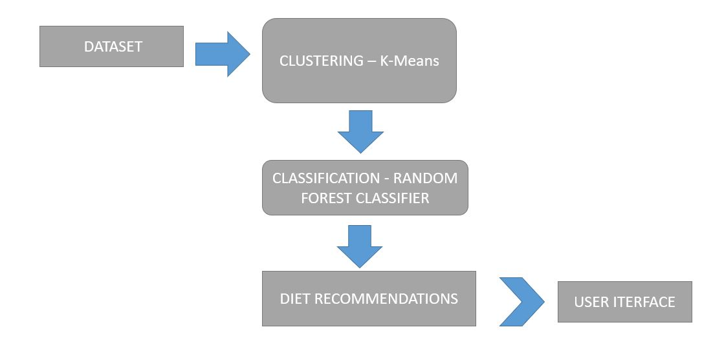
SYSTEM ARCHITECTURE

Slide 16
algorithm used
Random Forest

Slide 17
PERFORMANCE METRICS
Accuracy Metrics
Precision: 80-90%
Recall: 75-85%
F1-score: 78-88%
Mean Average Precision (MAP): 0.7 - 0.9

Slide 18
Personalization & User Satisfaction Metrics
Diversity: > 70%
Novelty: > 60%
User Satisfaction Score: 4.0 - 5.0 (out of 5)

Slide 19
Machine Learning Model Evaluation (if AI-based)
Mean Squared Error (MSE): < 0.05
AUC-ROC Score: > 0.85
Hit Rate (HR@K): > 90% (for K=5)

Slide 20
Modules
User Interface Module
Data Storage Module
Data Preprocessing Module
Recommendation Engine Module
Nutrition Analysis Module
Performance Monitoring Module
API Integration Module
Feedback & Review Module

Slide 21
References
1."Personalized Diet Recommendation System Using Machine Learning"
Authors: Praveen B.R, D. Navya Narayana Kumari, B. Manikanta, A. Phani Chandana, Y. L.S Aditya
Publication: SSRN Electronic Journal, 2024
2."Developing a Personalized Meal Recommendation System for Chinese Older Adults: Observational Cohort Study"
Authors: Not specified
Publication: JMIR Formative Research, 2024

Slide 22
references
3."Design Issues in Personalized Nutrition Advice Systems"
Authors: Not specified
Publication: Journal of Medical Internet Research, 2023
4."Personalized Nutrition for the Prediction of Glycemic Responses"
Authors: Zeevi D, Korem T, Zmora N, et al.
Publication: Cell, 2015

